Slide 1
My art portfolio
Yildiz Yildirim

Slide 2
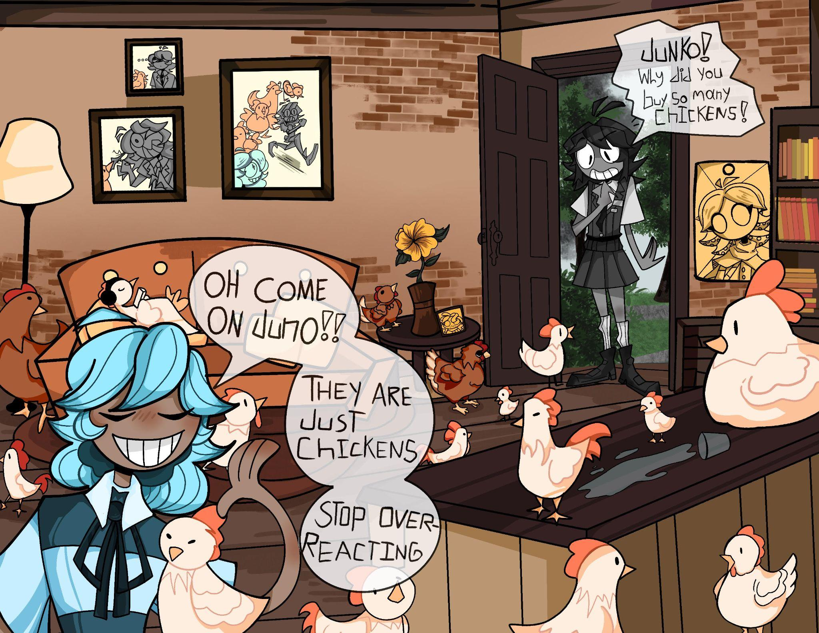
Title: “They are just chickens!”
Size(digitally): 11 x 8.5
Media: Digital

Slide 3
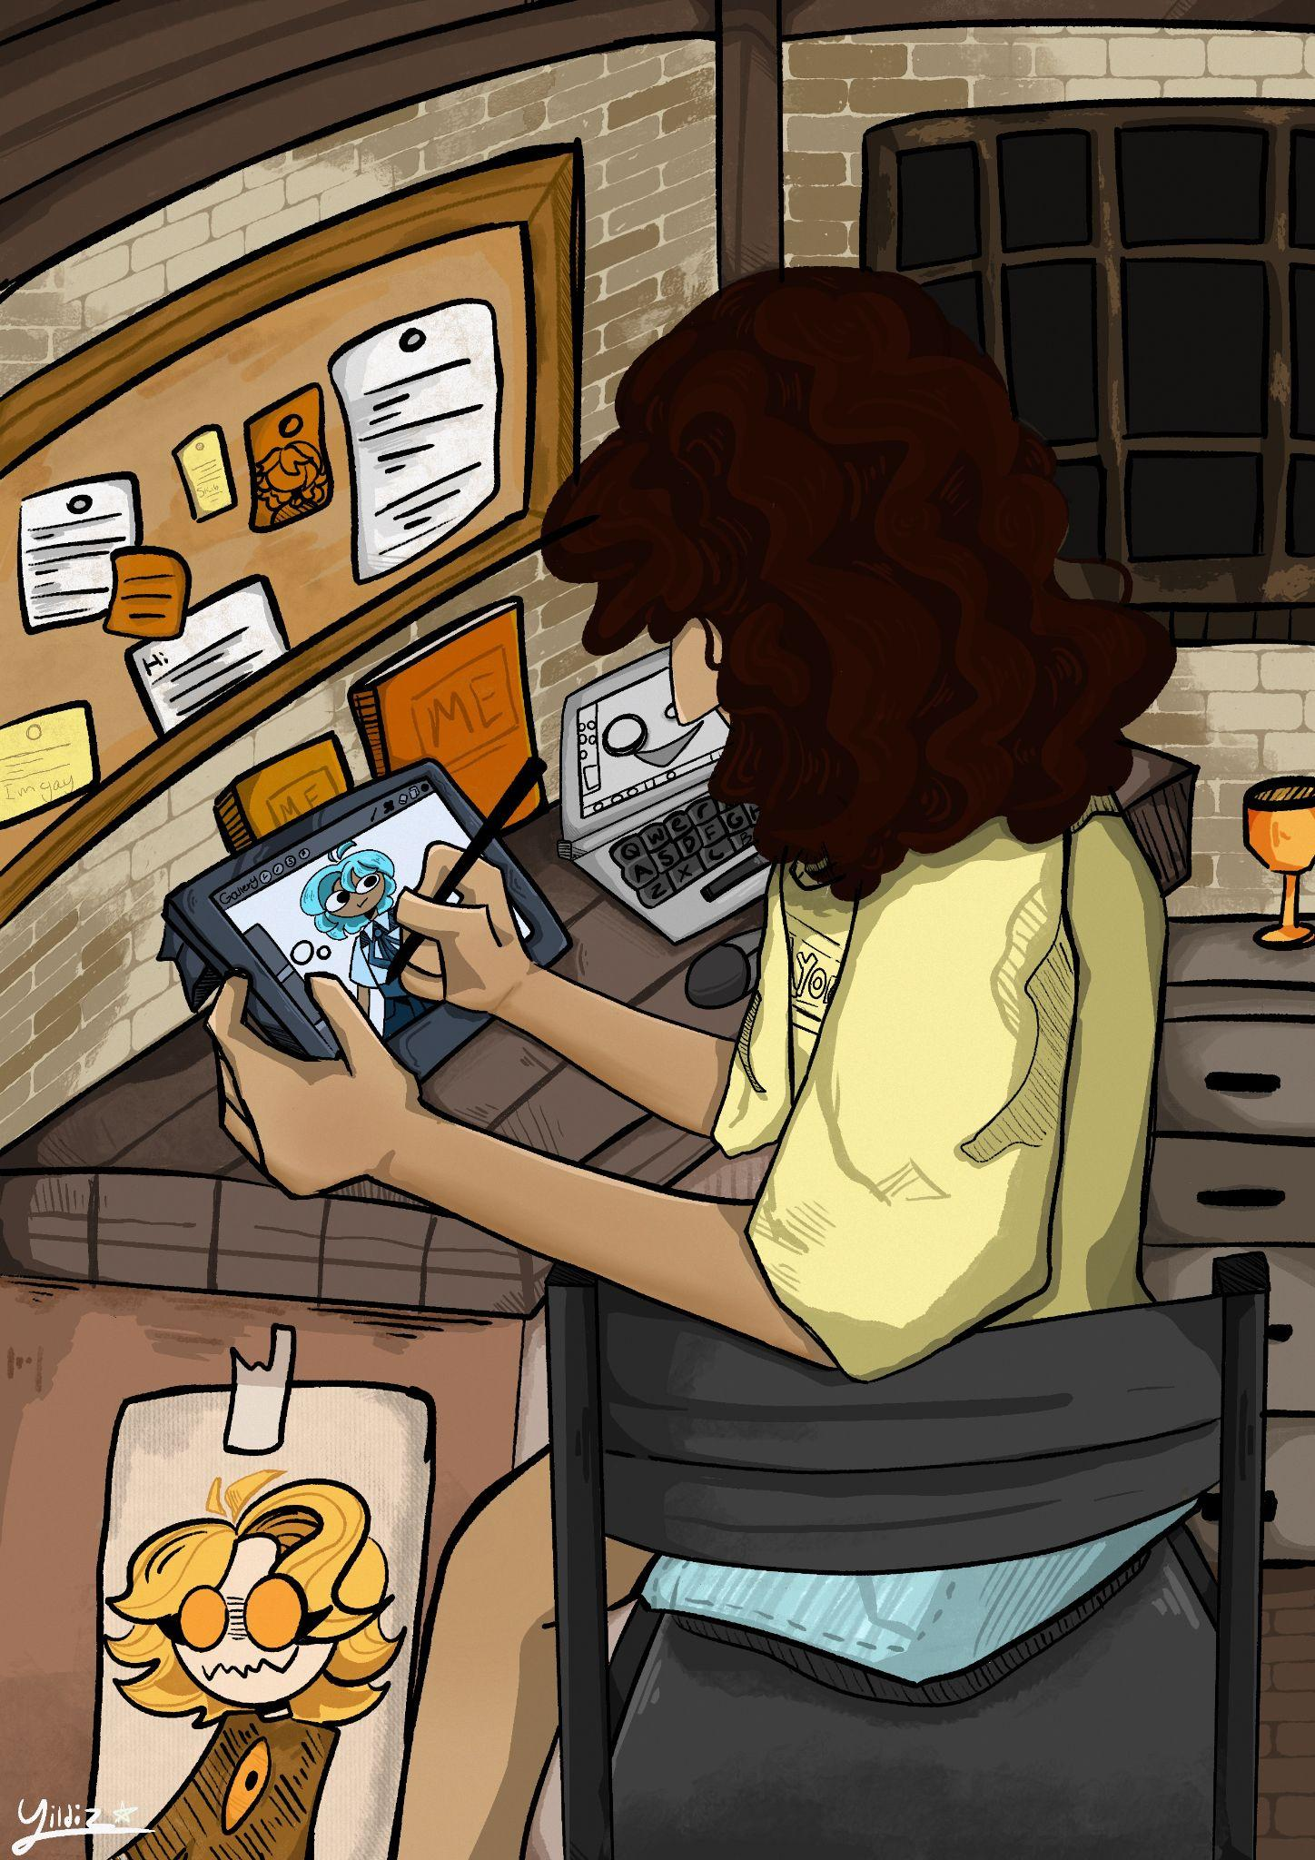
Title: “Me and Myself”
Size: 210 x 297
Media: Digital

Slide 4
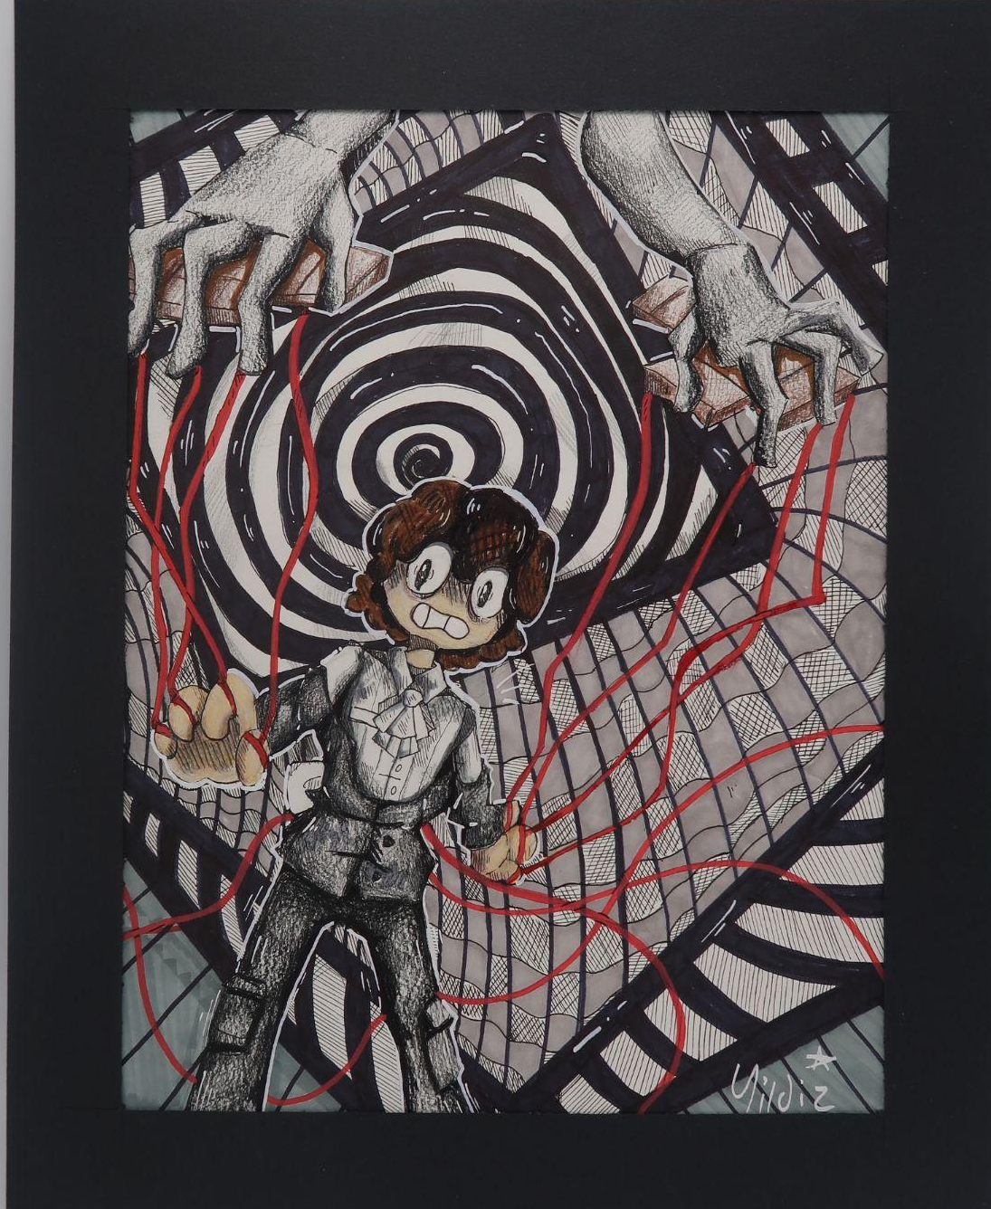
Title: “Controlled”
Size: 11 x 17 (I think)
Media: Mixed (sharpie, pen, colored pencils, alcohol markers, and acrylic markers)

Slide 5
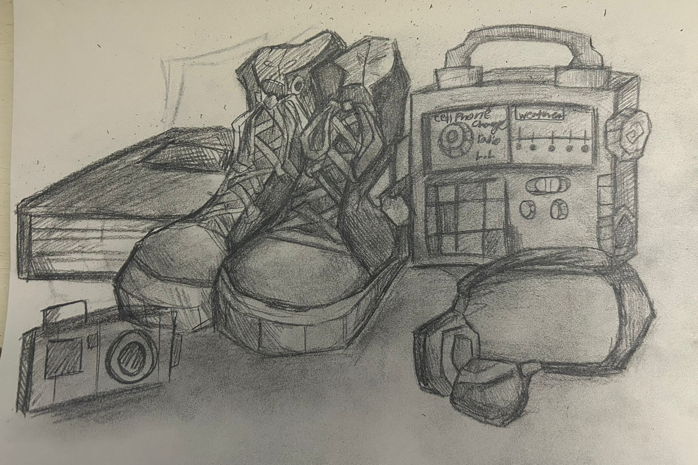
Title: Still life
Size: 8.5 x 11
Media: Graphite

Slide 6
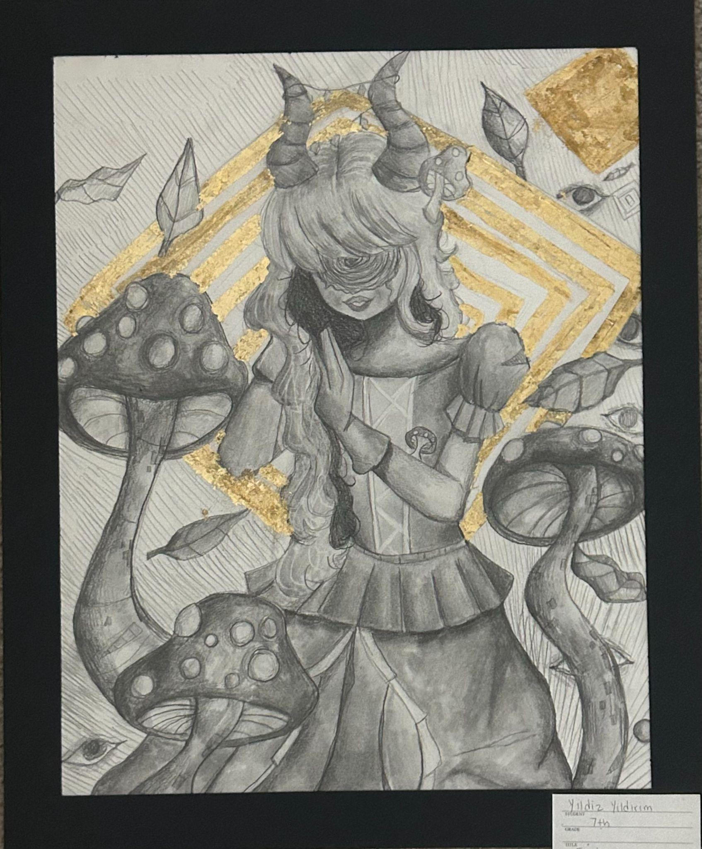
Title: “Who am I?”
Size: 11 x 17
Media: Graphite and gold leaf

Slide 7
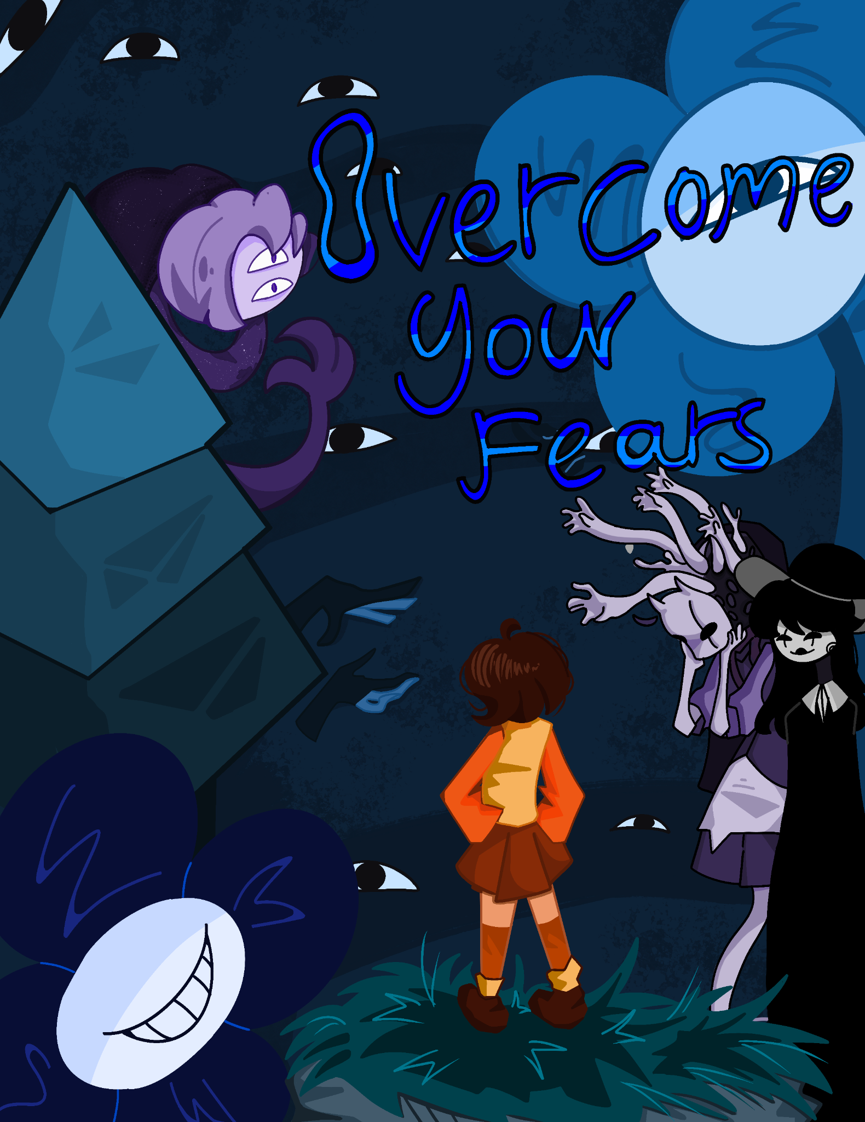
Title: Overcome Your Fears
Size: 8.5 x 11
Media: Digital

Slide 8
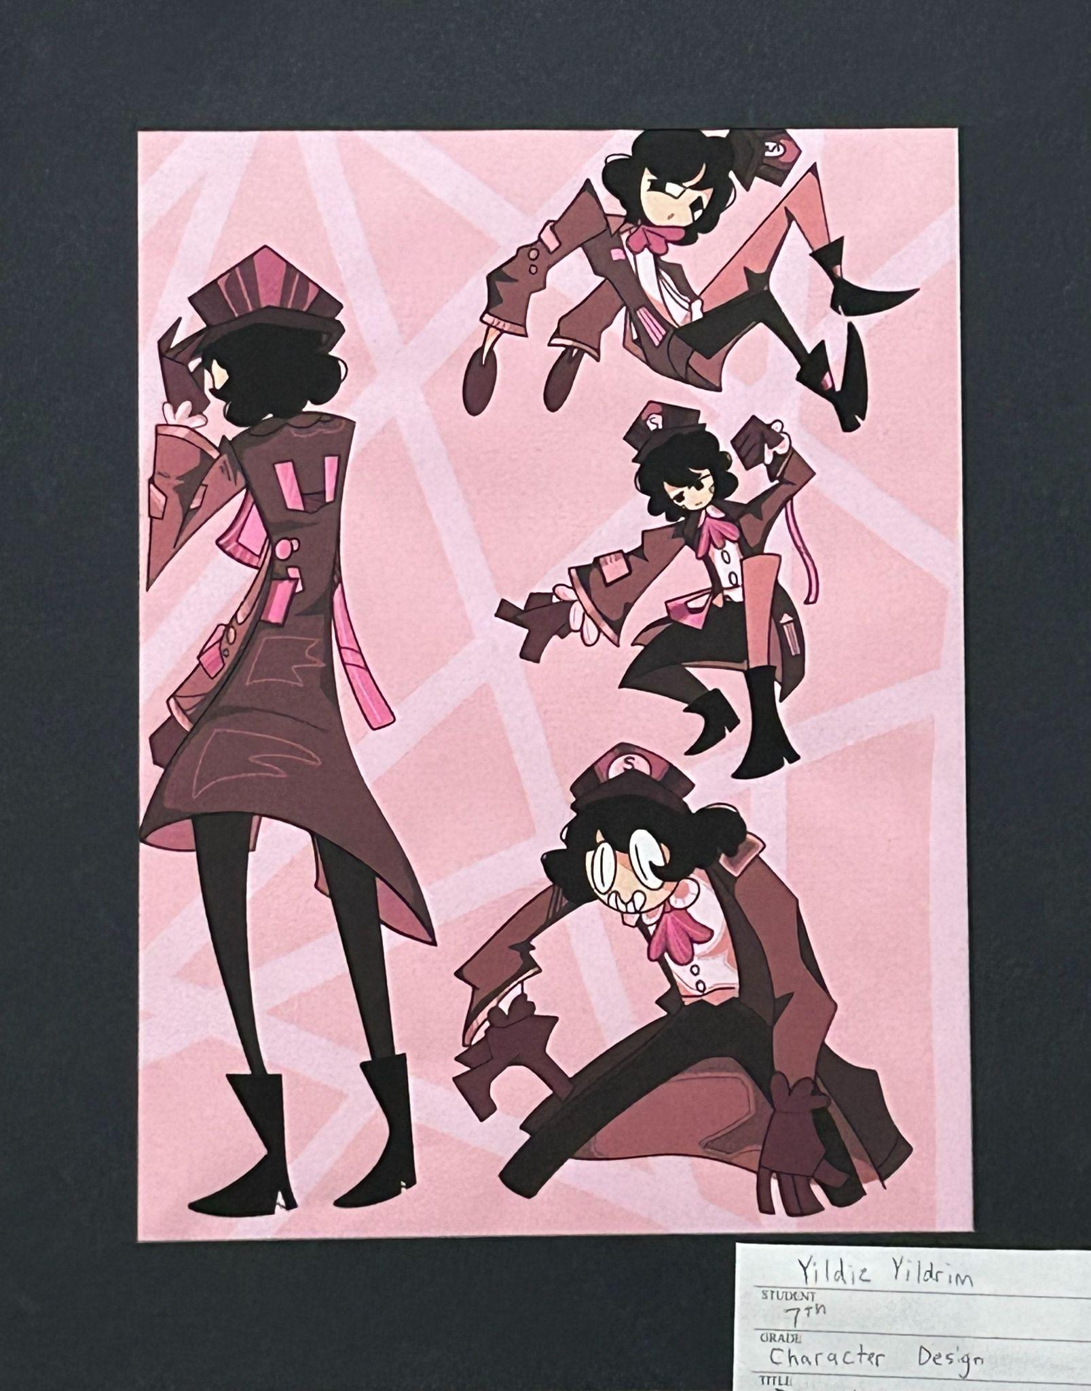
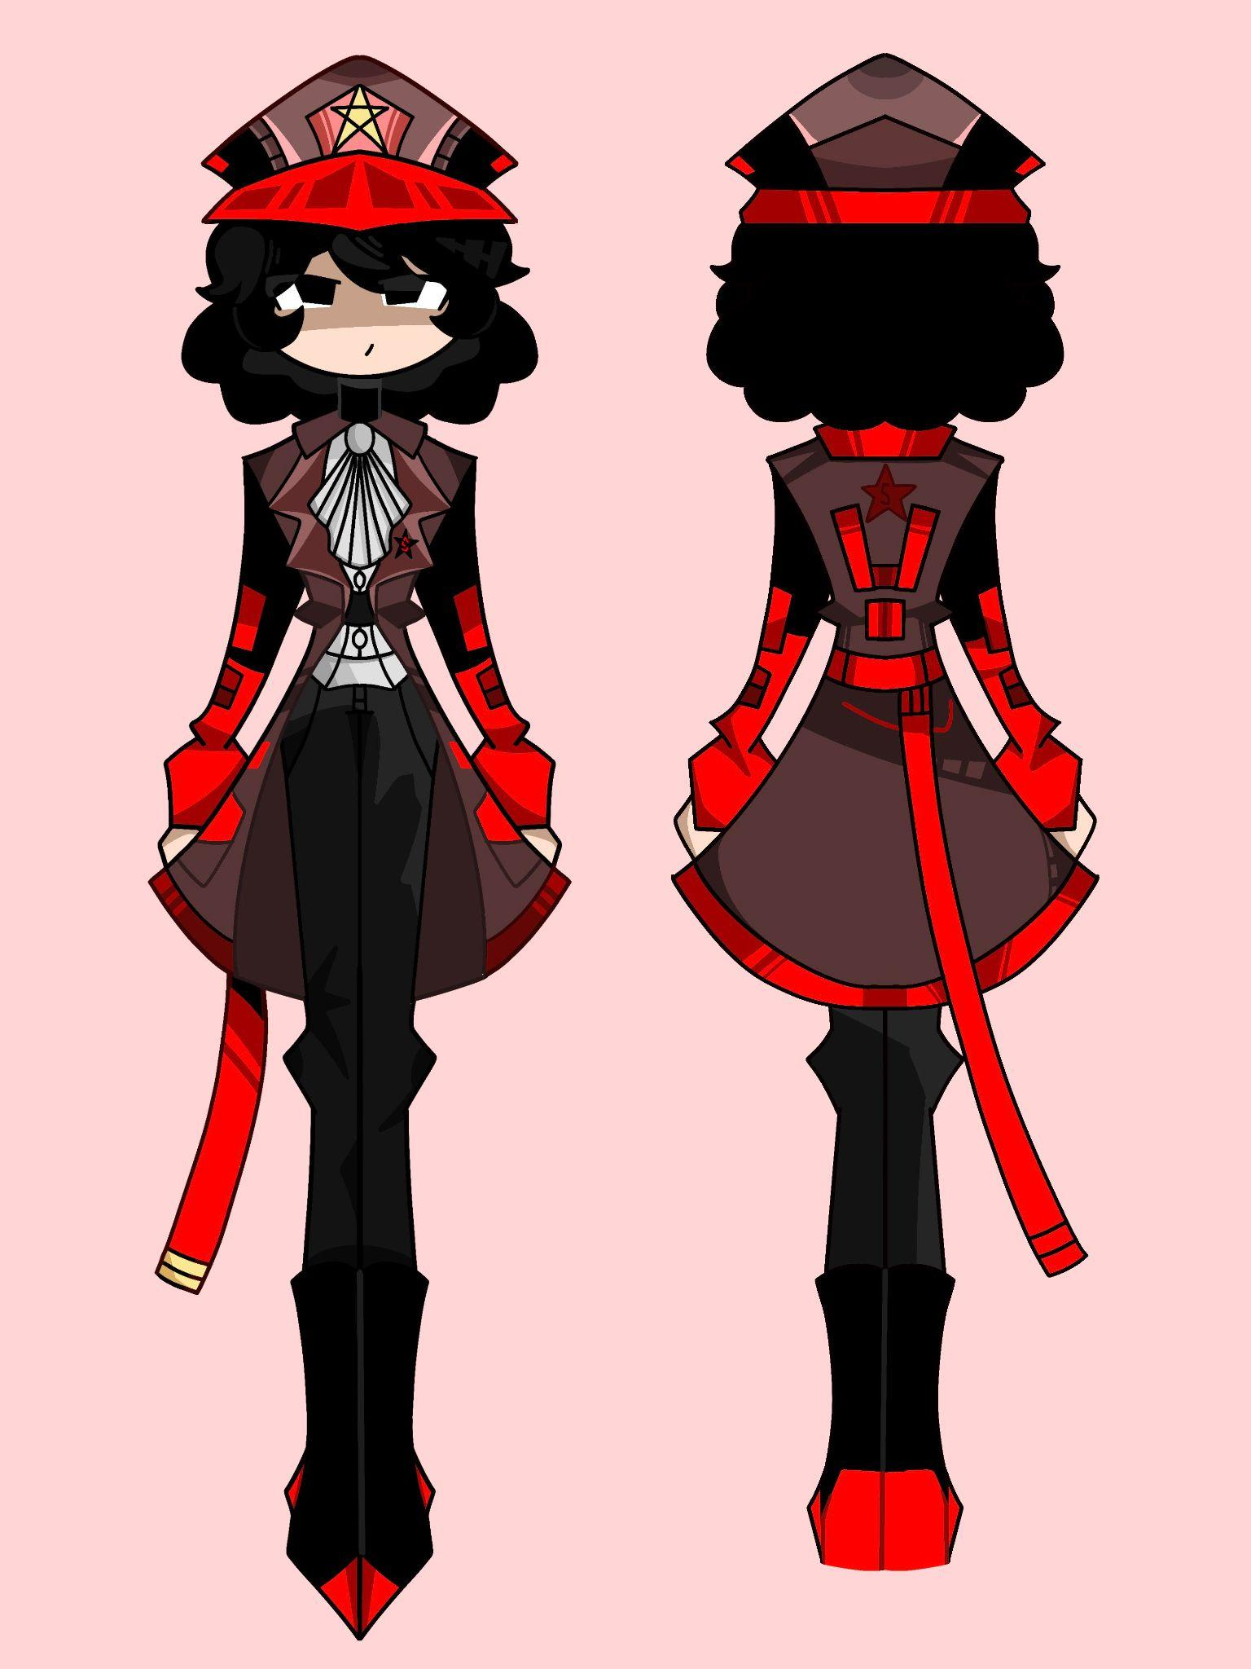
Title: Character design
Size (for both) 8.5 x 11
Media: digital

